Slide 1

Revision and exam tips
Connie Richardson
Carpe Diem Counselling and Coaching
www.carpediemperth.com.au
Facebook: Carpe Diem Counselling and Coaching

Slide 2
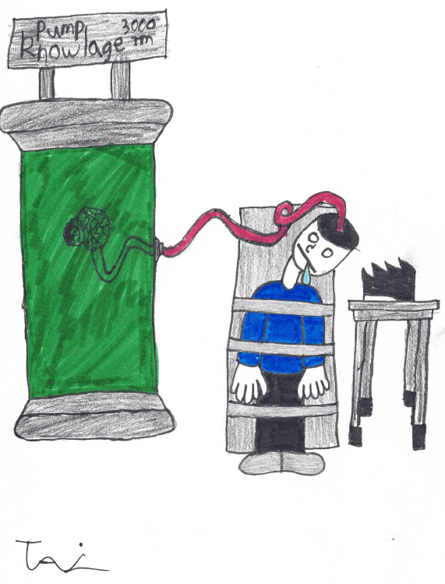
Why me?

Slide 3
1: Revision timetable
1 hour units
Allocate rest/fun time
Divide by number of papers/units, weight if necessary
Don’t spend too long on it!

Slide 4
2. Pyramid of revision
FOCUS
4321

Slide 5
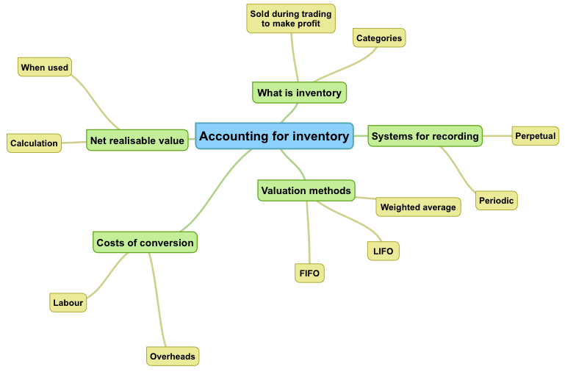
3. Mind maps/ notes
See: https://www.carpediemperth.com.au/tips-for-uni-part-2-studying/

Slide 6
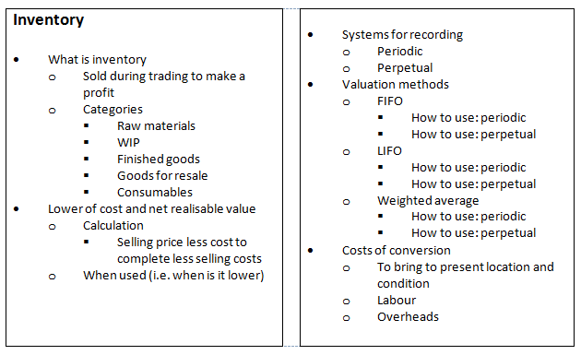
3. Mind maps/ notes

Slide 7
4. Practise questions
Practice links to passing
Read, do, review
Written: bullets first, full later
Mock exam

Slide 8
5. Don’t panic!
Don’t panic if you get something wrong
Learn from your mistakes
Numerical questions: follow through marks
Written questions: alternative right answer?
Swap with friends, give feedback

Slide 9
6. Breathe …
You’re in the exam … panic starts …
BREATHE!
Breathing tips
Polyvagal theory: Article

Slide 10
7. Reading the question
Read it like a lawyer
Break it down – look for linking words
  E.g. “Compare the responsibilities of internal and external auditors for the prevention, detection and reporting of fraud”
  E.g. “Calculate closing inventory at 30 June 2019 and cost of sales for the month of June using the FIFO periodic method”
  E.g. “Family Therapy is expensive, unpopular, has no evidence base and provides more ethical dilemmas than individual therapies. Discuss.”

Slide 11
8. Writing the answer
Writing clearly:
  “Why?”
  Give examples
Presentation:
  Please try to be neat
  Short paragraphs, line between
  Dark pen, underline headings (with ruler)

Slide 12
9. Other stuff
Timing: don’t “just finish off”
Do what you can’t do, don’t worry about what you can’t

Slide 13
10. Take care of yourself
Sleep
Healthy food, vitamins
Practise the breathing exercises

Slide 14
And finally…
Good luck, and thanks for listening
For more tips:
  https://www.carpediemperth.com.au/blog/
  Facebook: Carpe Diem Counselling and Coaching
Thank you to my lovely son for the artwork - $10 well spent ☺.

